Slide 1
GOES-R AWG Product Validation Tool Development
Lightning Application Team
Steve Goodman (NOAA, GOES-R System Program)
Richard Blakeslee (NASA-MSFC)
Monte Bateman (USRA)
William Koshak (NASA-MSFC)
Notes:
This presentation should reflect your current plans (and schedule) for the development of product validation tools (routine & deep-dive) for each of your products

Slide 2
OVERVIEW
Products
Validation Strategies
Routine Validation Tools
“Deep-Dive” Validation Tools
Further Enhancement and Utility of Validation Tools
Summary
Notes:
Plan on a 15-20 min presentation. Slide counts per topic area are provided as guidance. Slide counts will vary depending upon number of products and tools.

Slide 3
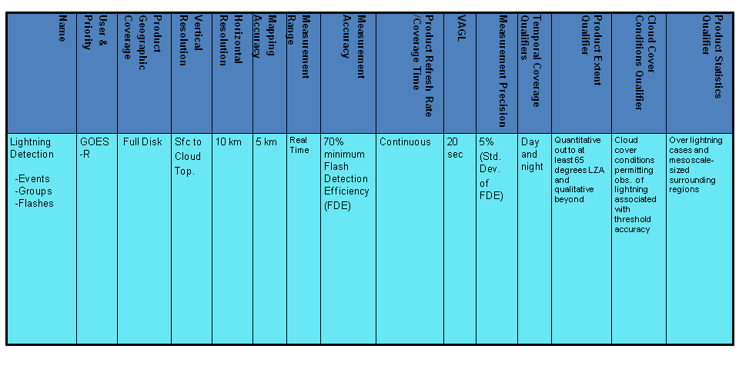
Products
Lightning Optical: Events, Groups, and Flashes
Notes:
Provide a list of products and their specifications (spatial and temporal resolution, coverage). Include an example display(s) of your products.

Slide 4
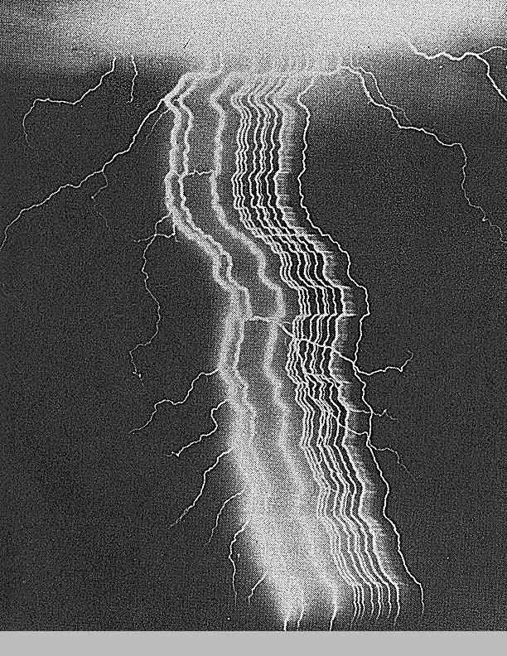
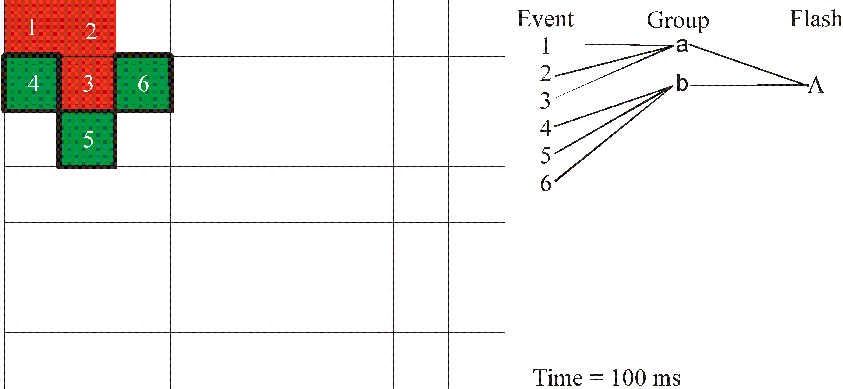
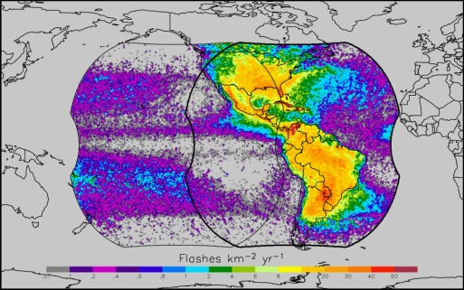
Products
(cont.)
Group a
... etc.
Group b
Groups Help Track Strokes & other
components of the flash.
.
.
.
etc.
Altitude
Plan View
(CCD Array)
time
Event: The occurrence of a single pixel exceeding the
background threshold during a single frame
Group: Two or more adjacent events in the same time frame
Flash: A set of groups sequentially separated in time by no more than 330 ms and in space by no more than 16.5 km
GLM
FOV
(1372 x 1300)
Notes:
SJG- cant read red on blue background- change red to yellow

Slide 5
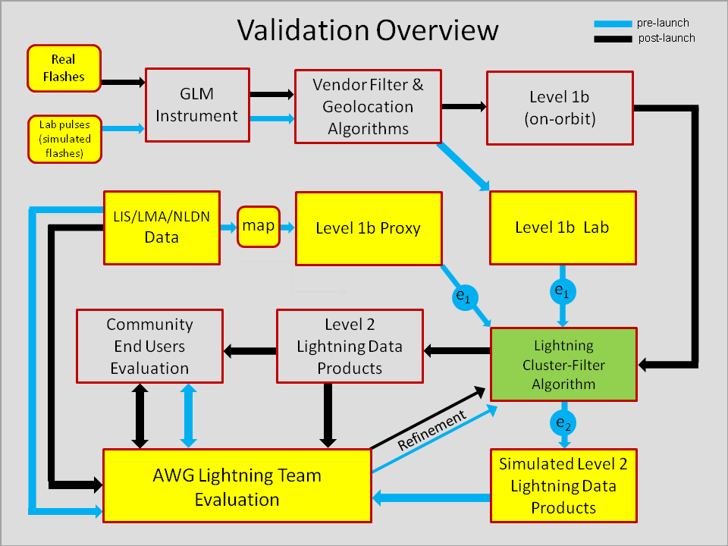
Validation Strategies
Approach has two phases:
  pre-launch evaluation phase given by the blue arrows.
  post-launch evaluation phase given by the black arrows.
Val
data
Evaluation
Evaluation
Notes:
Highlight/summarize validation strategy for each product. This first slide overviews the “Validation Flow”
Identify reference/”ground truth” datasets that are needed and where/how these are obtained – later slides will address this and next line.
Identify validation tools (routine & deep-dive) that are needed and being developed
RJB: refresh me again, what does e1 and e2 signify?

Slide 6
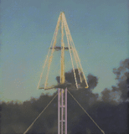
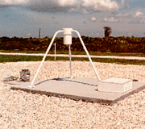
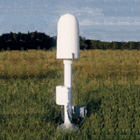
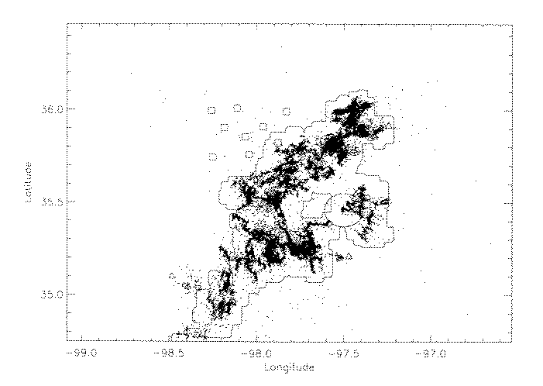
Val Data
Ground Truth Datasets:
  Short-Medium Range Lightning
    LMA (North Alabama, Oklahoma, DC, West Texas)
    LDAR II (KSC Florida)
    HAMMA (North Alabama)
    High Speed Video Cameras
    KSC Field Mills (KSC Florida)
    NLDN (CONUS)
  Long Range Lightning
    GLD360
    WWLLN
    WTLN
Also for Building the GLM Proxy
LIS optical
outline
LMA
VHF
Notes:
Highlight/summarize validation strategy for each product.
Identify reference/”ground truth” datasets that are needed and where/how these are obtained – this slide begins to address the needed data sets
Identify validation tools (routine & deep-dive) that are needed and being developed
RJB: it may be obvious but I added “Lightning” in data set titles
SJG: Show HAMMA data during LIS overpass

Slide 7
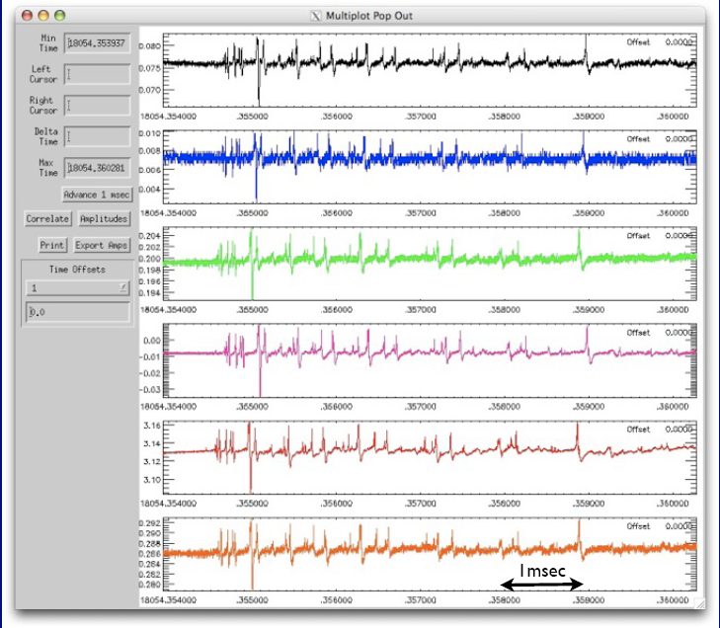
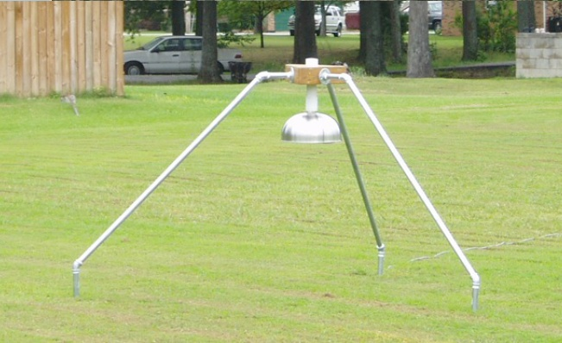
HAMMA Network
(Huntsville Alabama Marx Meter Array)
6 station network in N. Alabama
More information content than LMA
Can see preliminary breakdown, return stroke, and electrostatic changes
Used as a time-of-arrival (x,y,z,t) RF source retrieval system
Also provides electrostatic field changes to retrieve lightning charge
Will use to determine what part of lightning process GLM detects
Will also use to examine GLM detection sensitivity & continuing currents

Slide 8
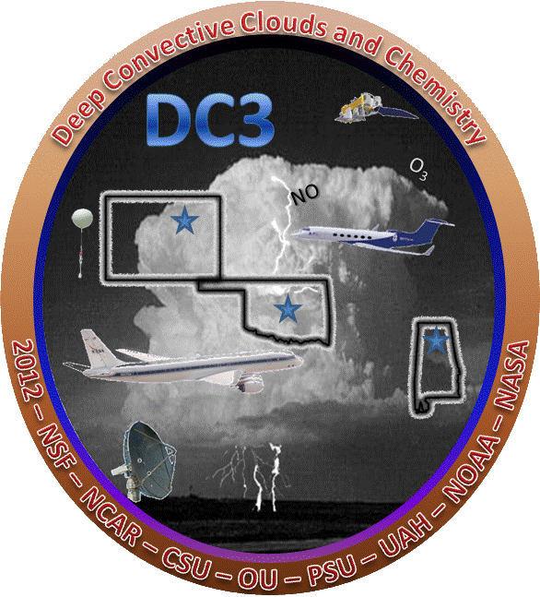


Val Data (cont.)
Additional Ground-Based Systems for Field Campaigns
  CHUVA (beginning Oct 2011)
    SPLMA (Sao Paulo Brazil)
  DC3 (May-June, 2012)
    FCLMA (Fort Collins Colorado)
  HyMeX (beginning Sept 2012)
    Possible deployment of MLMA (Mediterranean region)
Notes:
Highlight/summarize validation strategy for each product.
Identify reference/”ground truth” datasets that are needed and where/how these are obtained
Identify validation tools (routine & deep-dive) that are needed and being developed

Slide 9
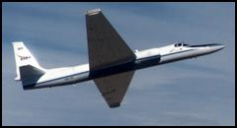
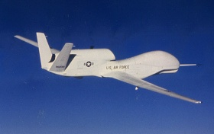
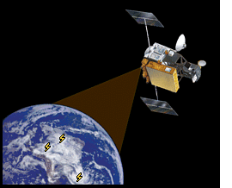

Val Data (cont.)
Airborne GLM Simulator
  Build an airborne detection system that will make high resolution optical measurements as a GLM simulator.
  Deploy on aircraft (e.g., ER2, Global Hawk) to observe cloud-top lightning pulses (target DC3, HS3, other field campaigns).
Satellite Observations
  LIS
    GLM proxy data development
    Pre-launch validation simulations (including val tool testing)
    Pursue opportunity to a LIS on International Space Station
  TARANIS (Tool for the Analysis of RAdiation from lightNIng and Sprites)
    Launch 2015, CNES/France; nadir staring (2 cameras, 4 photometers)
    Directly compare with GLM data
  Cross-calibration between GLM and MTG LI (2017)
Credit: CNES/Ill. D. Ducros
Notes:
Highlight/summarize validation strategy for each product.
Identify reference/”ground truth” datasets that are needed and where/how these are obtained
Identify validation tools (routine & deep-dive) that are needed and being developed
RJB: made some significant edits on this slide. We can decide whether or not to keep LIS on ISS bullet (if that happened we would have another sensor for direct comparison to GLM
SJG- Is NASA LIS ISS likely and when ?- if so list TBD. Also 2017 Cross-cal between MTG LI and GOES-R GLM

Slide 10
Definitions: Basic Val Tool Types
GLM Proxy Creation Tool
  A tool used to create simulated GLM data (level 1b or level 2).
LCFA Performance Validation Tool
  A tool that validates the performance of the Lightning Cluster Filter Algorithm (LFCA) using either simulated or actual GLM data.
    Important: only the LCFA in isolation is being validated by these tools.
    The Algorithm Implementation & Test Plan Document already describes some of these tools (and LCFA performance results); LCFA resiliency, accuracy, and speed were characterized.
GLM Validation Tool
  A tool that validates the end-to-end performance of the GLM using either lab-simulated or actual GLM data.
    Validation can employ ground, air-borne, or satellite truths.
    Both level 1b and level 2 data are evaluated.

Slide 11
Routine Validation Tools
Lightning Monitoring Tool (LMT) will monitor the following:
Instrument Health/Operation: by ingesting housekeeping and other meta-data on continuous basis.
Instrument Degradation: using periodic reports on DCC analyses (& other physical target analyses) that flag instrument degradation.
Individual Pixel Sensitivity: using periodic reports on pixel fidelity.
GLM Products: using truth data and the VaLiD shallow dive “engine” (see later).
  Display any problem with the LCFA by monitoring flags (metadata) in the L2 stream that communicate problems (time, space and overflow) in the clustering process.
  Will routinely report on lightning product statistics and assess reasonableness.
  Compare GLM to other available data (e.g., clouds, other lightning data) to verify that GLM is seeing lightning where expected (and vice-versa).
INR: using periodic reports on IR background (from ABI, GLM).
INR: using periodic reports from laser beacon analyses.
INR: using lightning NLDN/LMA ground truth @ night (if needed).
Notes:
RJB: Some changes made. We should discuss the first bullet.
Will ingest any other available data
ground: NLDN, WWLLN, WTLN, various LMA
space: LIS (if available)
Will grid all data into 5° × 5° boxes and look at totals & trends.
Will output maps with the 5° × 5° boxes colored in stoplight fashion (green, yellow, red)
If GLM doesn't match others (consensus) in a particular box, will investigate further as to why
If red, software will try to offer a guess as to what is wrong.

Slide 12
Lightning Monitoring Tool (LMT)
“STOP LIGHT”
ALERTs
Instrument
Health/
Operation
(CONTINUOUS)
VaLiD
Shallow dive mode
Deep dive mode
INR flagging
ABI/GLM background
Lasers
Nocturnal lightning
Instrument Degradation
DCC radiance analyses
deserts, other targets
pixel sensitivity logging
The “stop light” alert output of the LMT is based on inputs
(white arrows) the LMT receives. A red or yellow alert could
trigger more in-depth “deep dive” analyses.

Slide 13
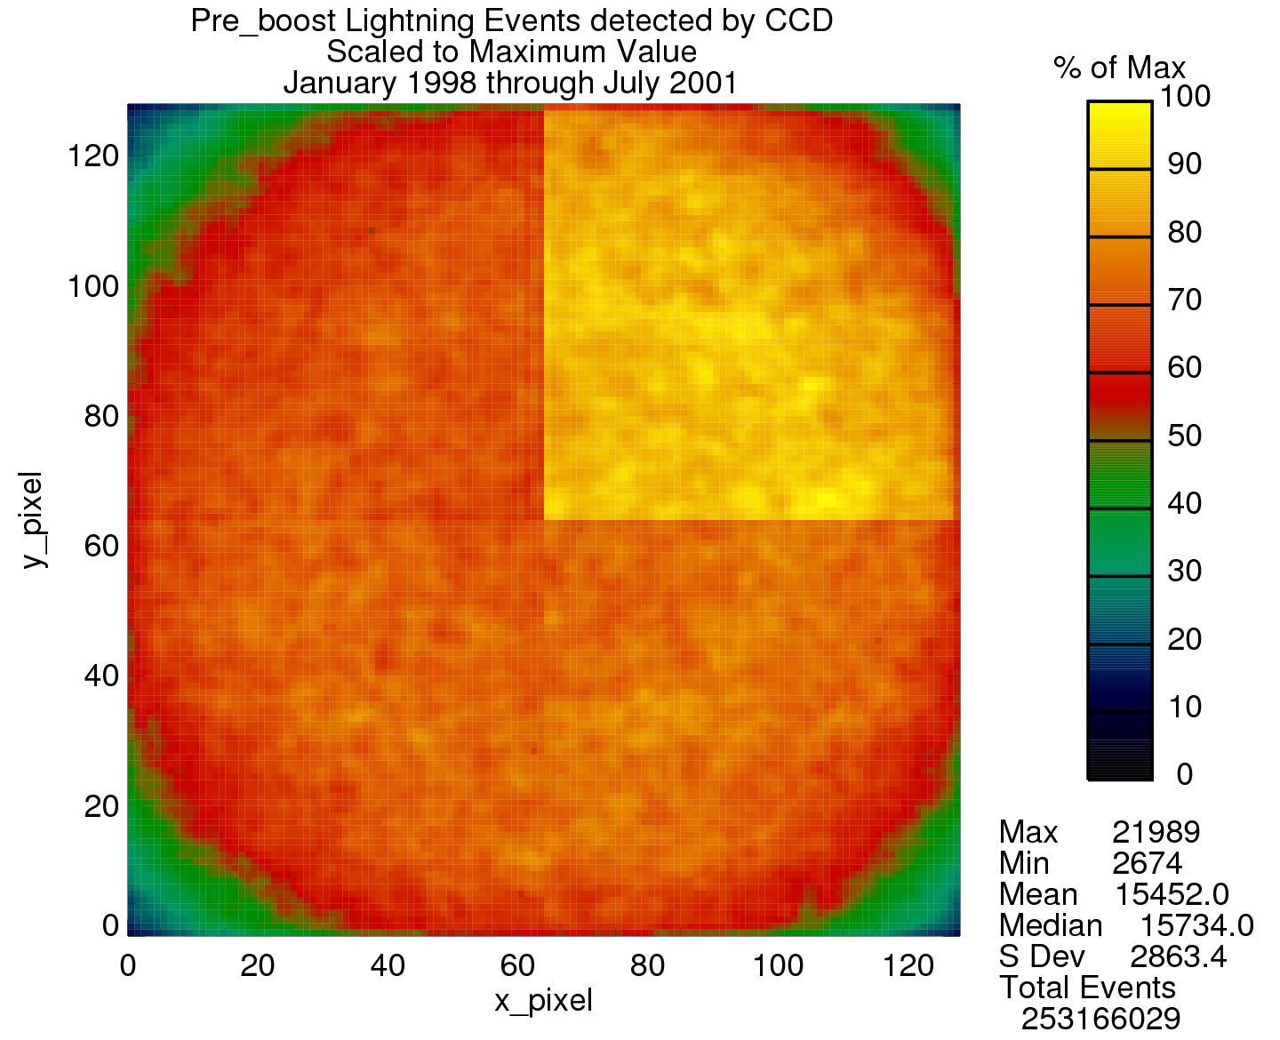
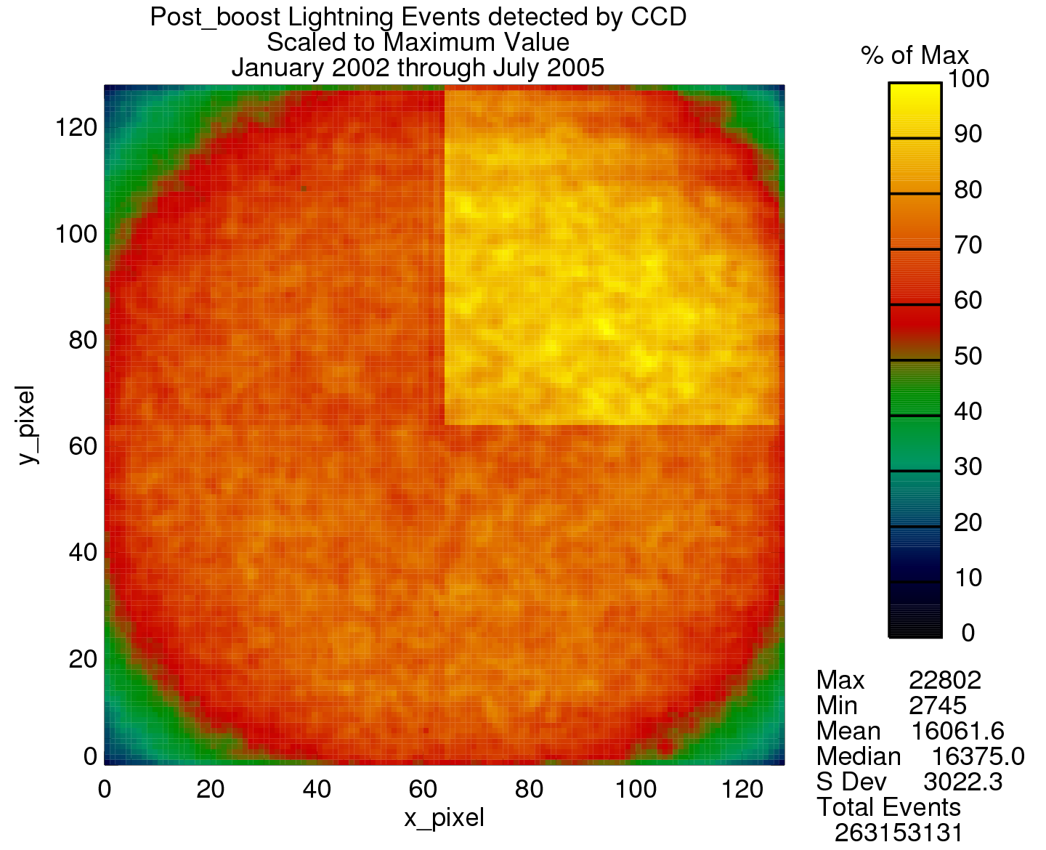
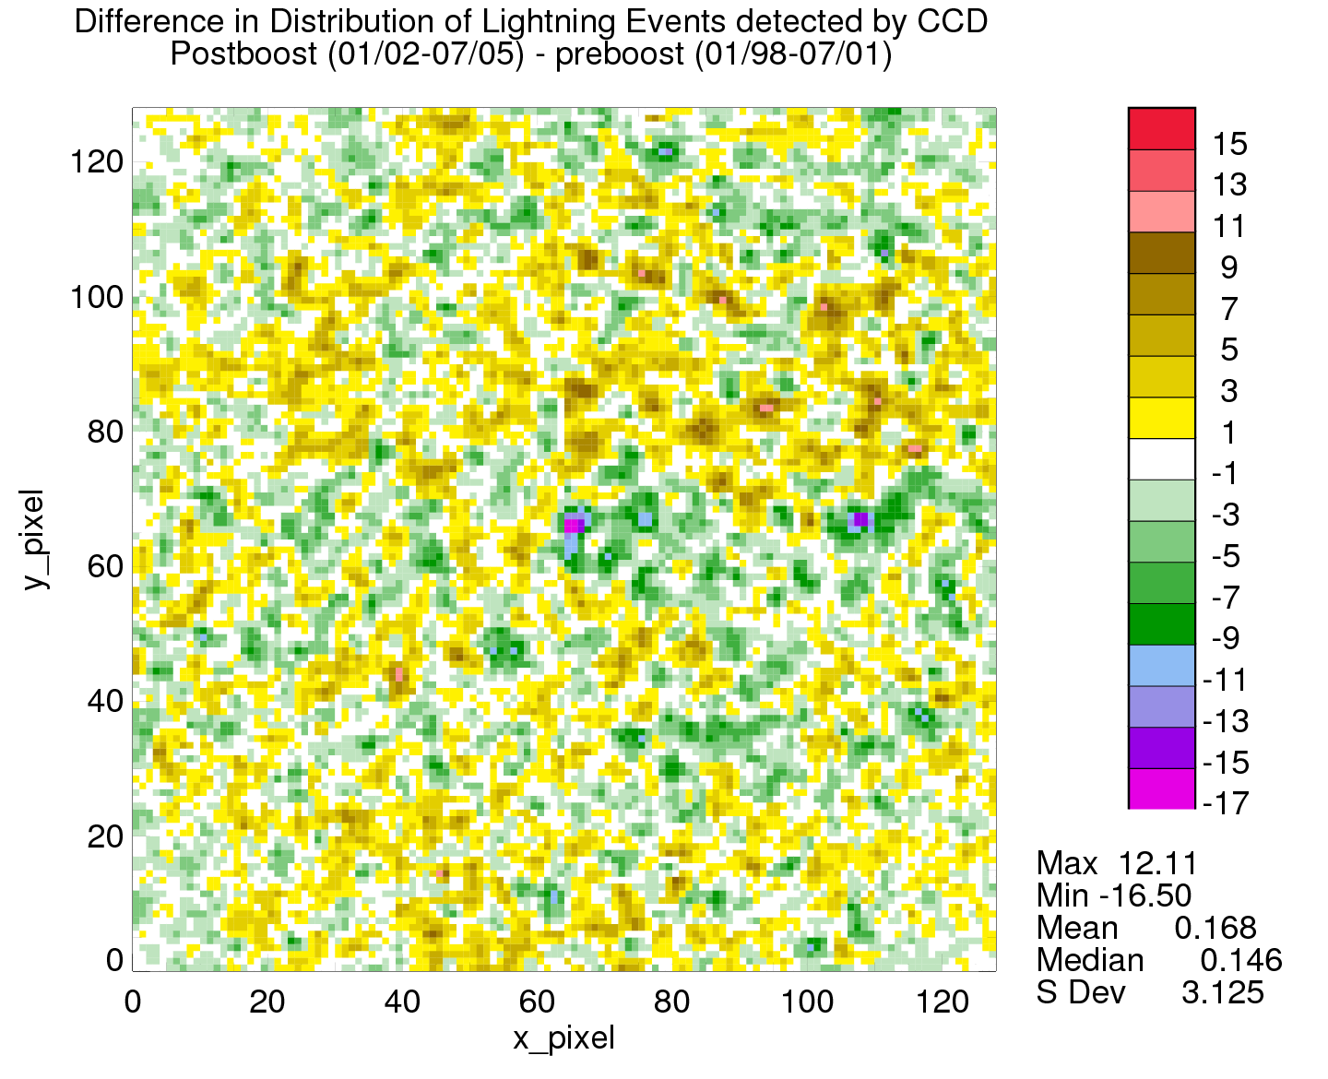
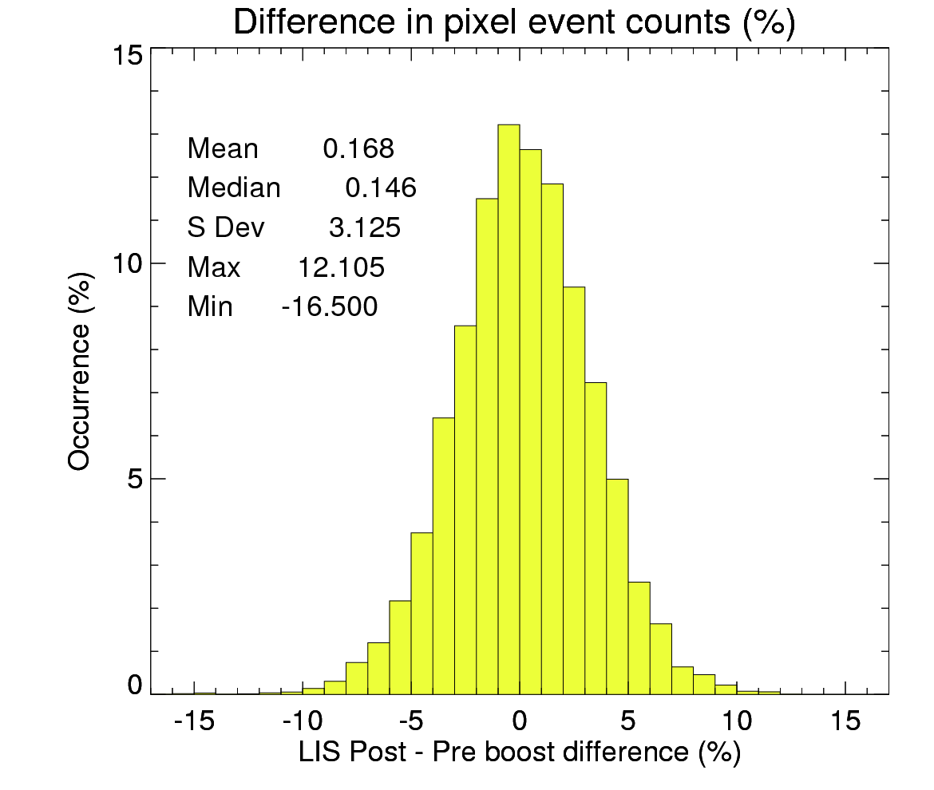
Monitoring Pixel Sensitivity
post-boost pixel array (Jan 02 - July 05)
pre-boost (Jan 98 - July 01) pixel array
post-boost pixel array (Jan 02 - July 05)
post-boost – pre-boost
TRMM/LIS Ex.- Time period for the post boost same as the pre-boost so that the amount of time analyzed would be the same
Filtered data (i.e. Events that made it through all the various filters and ended up in flashes) at each pixel in the CCD array
CCD values scaled by the maximum value to get a percent of maximum.

Slide 14
Analytical
Validation Tools
VaLiD — “Shallow Dive” mode
  VaLiD = Validate Lightning Detection
  Will ingest data from multiple sources
    Ground: NLDN, WWLLN, WTLN, various LMA
    Space: LIS (if available)
  Will plot some/all these data with GLM data (as desired by operator)
  Will show lightning totals and trends
  Can click on the live map and trigger “Deep Dive” mode

Slide 15
Analytical
Validation Tools
VaLiD — “Deep Dive” mode
Will be able to look at individual events, groups and flashes to assess resiliency, accuracy and speed
Plot products, LMA flashes/sources and/or other available/selected data (NLDN, WTLN, WWLLN, HAMMA, etc.)
Will give a flash-by-flash assessment of the inter-system comparison of all lightning detection systems
Will be able to assess flash detection efficiency
15
Notes:
RJB: Some changes made (bullet 2)
5/6/2011
15

Slide 16
Pre-Launch
Validation Tools
V1 Complete
Current proxy is based on LMA data
Have tools that validate GLM proxy pixels (L1b) and proxy flashes (L2)
Also assesses resiliency, accuracy & speed of the LCFA
Assesses the quality of the proxy pixels (L1b) — realistic? challenging enough to stress the LCFA?
(v2) Need to generate L1b pixels from other sources besides (NA)LMA
(v2) Need to run these proxies through VaLiD to test it
16
Notes:
5/6/2011
16

Slide 17
Post-Launch
Validation Tools
VaLiD and the LMT need to be functioning
They will need to be "tweaked" post-launch (cannot guess alert thresholds pre-launch)
May be able to also use satellite images (or GLM background images) to enhance both tools
17
Notes:
RJB: minor changes
SJG- GMT?
5/6/2011
17

Slide 18
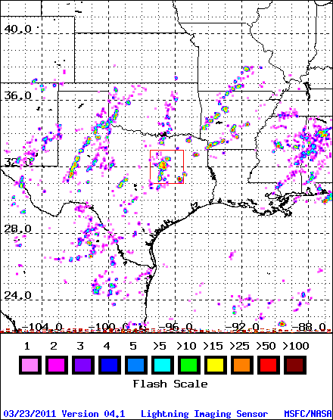
Further Enhancement and Utility of Validation Tools
ZOOM Feature
as presently done for LIS …
1. Click a location & period
2. Define box dimensions
3. Spill out stats for box
18
Notes:
Please provide your thoughts and ideas for enhancing the capabilities and utililty of the validation tools beyond what you already planned to do. For example:
1) Could your matchup databases support product reprocessing?
2) What new visualization technologies could be used to further enhance the capability/utility of a routine or “deep-dive” validation tool?
3) What web interfaces to your validation tool outcomes could/should be developed (if not already developed)?
4) Other ideas?
5/6/2011
18

Slide 19
Summary
Goal of GLM validation is to ensure that GLM products (events, groups, flashes)
  are adequately detected
  accurately located in space and time, and with proper latency
To accomplish this, we are developing various val tool types:
  GLM proxy creation tool
  LCFA performance validation tool
  GLM validation tool
These tools require many truth datasets:
  ground
  air-borne
  satellite
Our coordinated efforts will lead to development of Lightning Monitoring Tool (LMT) which relies on several routine analyses and aperiodic data reports that involve both “shallow and deep dive” investigations.
19

